Slide 1
A Multidimensional Bayesian Approach to Pothole Occurrence in Toronto (2025–2026)
Gabriel Mantilla

Slide 2
This project transforms how we understand urban infrastructure by moving from a reactive "report-and-repair" cycle to a Proactive Risk Assessment model for the City of Toronto. By merging 2025–2026 311 service data with high-resolution atmospheric variables, the study identifies the precise "Weather Regimes" that trigger road failure.
The Methodology
We use of Bayesian Gaussian Mixture Regression (BGMR) for predict the probability of occurrence of Number of Pothole in January 2026. Unlike standard models, BGMR maps the joint distribution of six environmental pillars—including Relative Humidity (RHUM), Atmospheric Pressure (PRES), and Precipitation (PRCP). This allows us to calculate Exceedance Probabilities, turning raw weather data into a predictive "Health Monitor" for the city's streets.
Key Data Innovations
Normalization: We shifted the metric from raw complaint volume to Intersection-Day Occurrences. This eliminates reporting bias (where one hole gets fifty calls) and focuses on unique structural failure events.
Precision Mapping: A three-month manual verification process using Google Maps ensured that thousands of intersections were geocoded with high accuracy, overcoming the limitations of automated scripts.

Slide 3
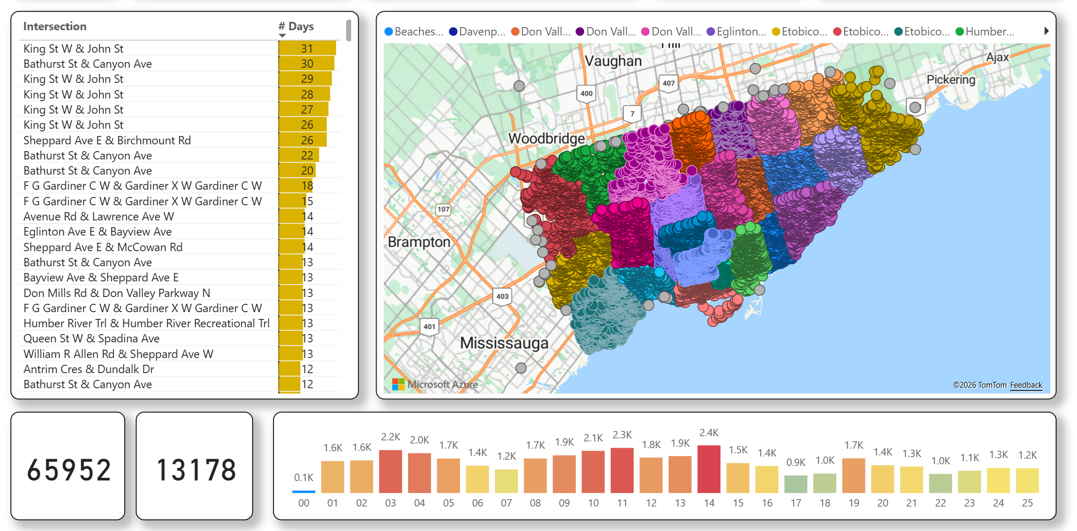
Descriptive Analysis

Slide 4
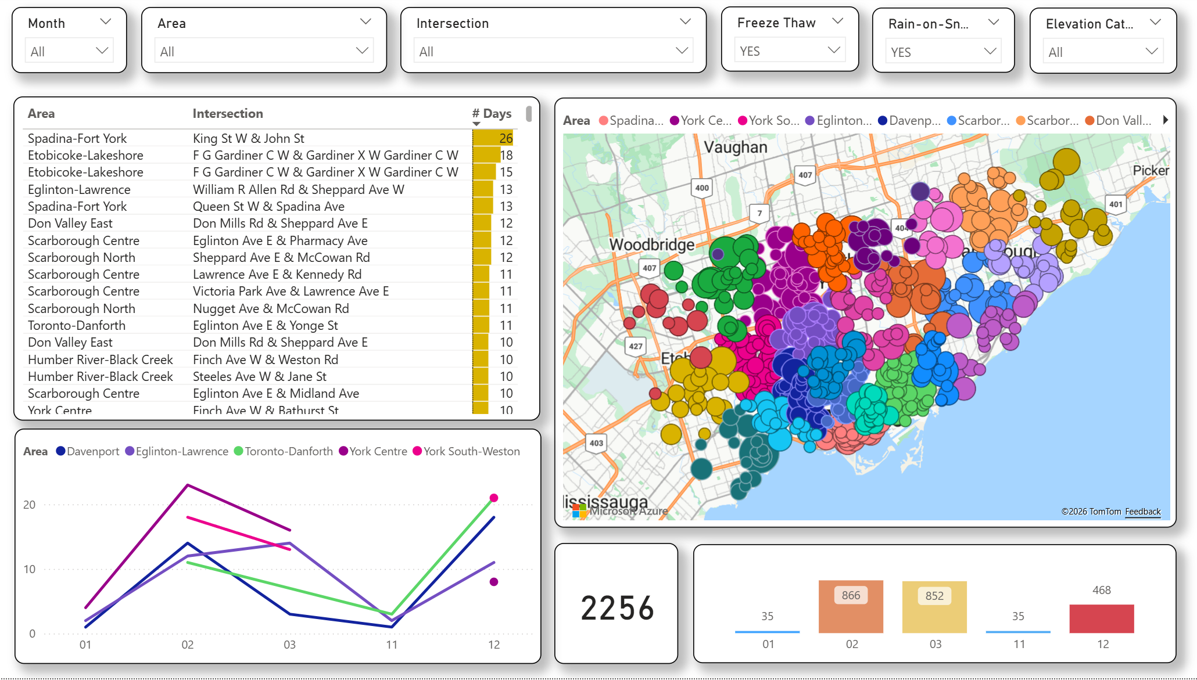
Freeze-Thaw Correlation & Precipitation & Snow Depth Impact
The "Freeze-Thaw“ corr.
This is the "smoking gun" for potholes. Potholes form when water enters cracks, freezes (expands), and then thaws (leaves a void). Count how many days the temperature "crossed zero" (TMIN < 0 and TMAX > 0).
The Rain-on-Snow (ROS)
This is a specific weather phenomenon that acts as a "perfect storm" for destroying roads and infrastructure. There is at least 5cm of snow on the ground, significant rainfall, and it is warm enough for the rain to stay liquid and melt the snow (SNWD > 5, PRCP > 5 and TMAX > 0)

Slide 5
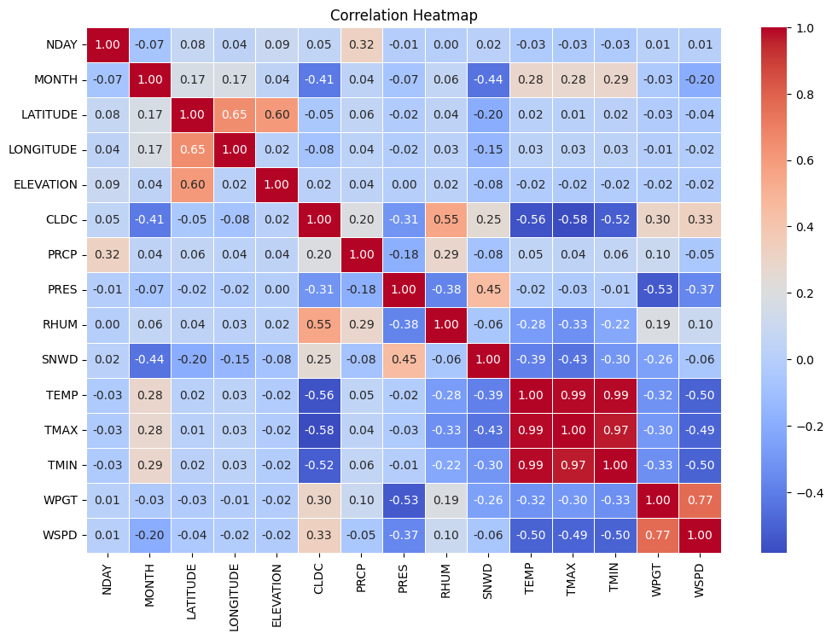
Pearson Correlation Matrix
A correlation matrix is a table displaying correlation coefficients between multiple variables, measuring the strength and direction of linear relationships.
Ranging from -1 to +1, it highlights, through color-coding or values, how pairs of variables move together, with on the diagonal, indicating perfect self-correlation

Slide 6
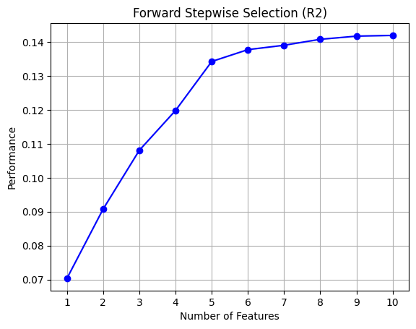
Stepwise Selection
Forward Selection: Starts with zero features. It adds the one feature that improves the model the most, then the next, and so on, until a specified number of features is reached. SFS can operate in forward mode (start with an empty set and add features)
"SFS" likely refers to Sequential Forward Selection, a feature selection method that can be used with a LinearRegression model to choose an optimal subset of features in Python. The mlxtend library provides a convenient way to implement this process. Greedy Algorithm: SFS is a greedy algorithm that iteratively adds the single feature which results in the best model performance at each step, based on a cross-validation score.
No Feature Importance Required: Unlike some other methods like Recursive Feature Elimination (RFE), SFS does not require the underlying model (like LinearRegression) to provide coef_ or feature_importances_ attributes.
Model Agnostic: It can be used with any machine learning model that provides a scoring function.
SFS is a "wrapper" method. This means it evaluates different combinations of features by actually training a LinearRegression model on them and seeing how well they perform.

Slide 7
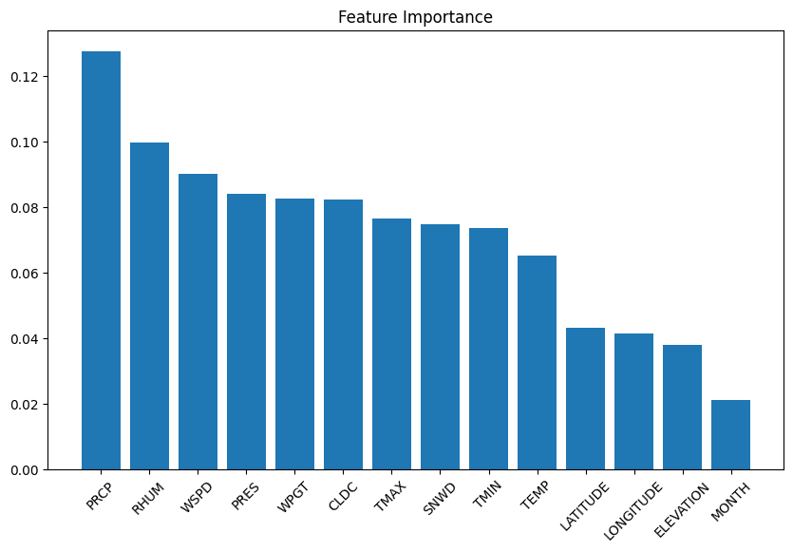
Feature Importance (Random Forest)
While SFS is a "wrapper" method that tries different combinations, Random Forest has a built-in "embedded" feature ranking. It’s one of the most popular tools for feature selection because it handles non-linear relationships much better than a standard Linear Regression.
How it Works: "Mean Decrease in Impurity"
A Random Forest is made of hundreds of Decision Trees. Each time a tree splits a node based on a feature, it's trying to make the resulting groups "purer" (e.g., separating "Survived" from "Not Survived" in a Titanic dataset).
Feature Importance is calculated by looking at:
Frequency: How often a feature is used across all trees.
Impact: How much the "Gini Impurity" or "Entropy" decreased every time that feature was used for a split.

Slide 8
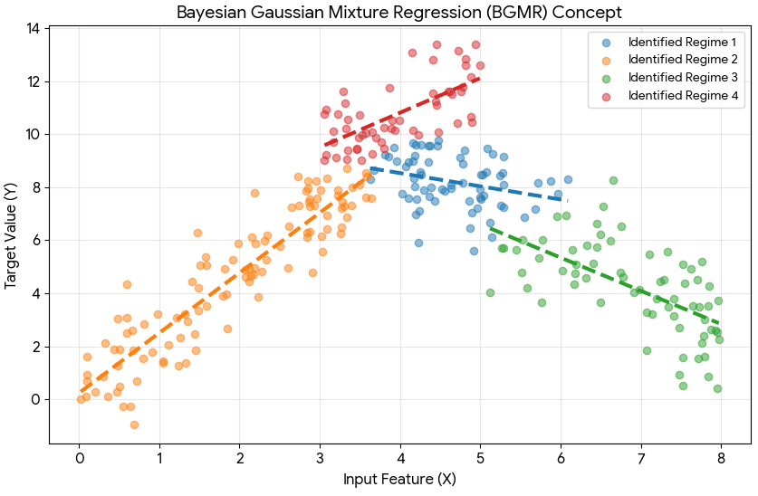
Model: Bayesian Gaussian Mixture Regression
A Gaussian mixture model (GMM) is a probabilistic model that represents data as a combination of several Gaussian distributions, each with its own mean and variance, weighted by a mixing coefficient. GMMs are commonly used for clustering and density estimation, since they can capture complex, multimodal distributions where data points may naturally group around different centers rather than a single mean.

Slide 9
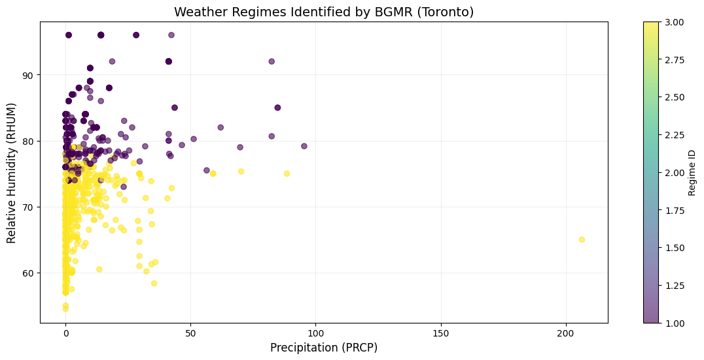
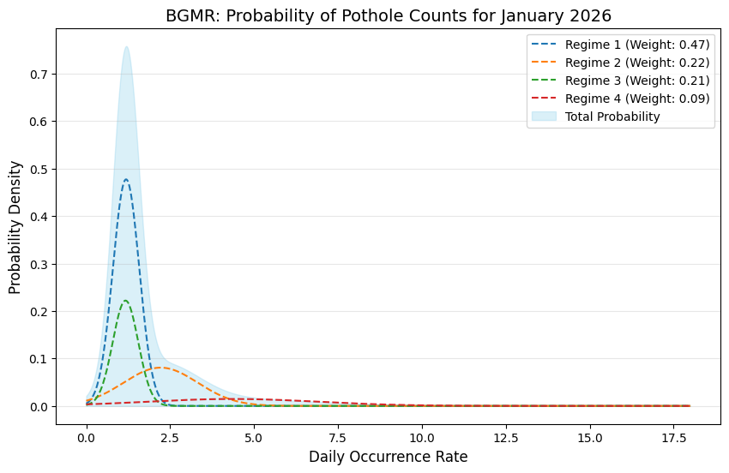
Model: Regimes
To begin with the last part of the project, which is to predict Distinct Intersection-Day Occurrences or Daily Occurrence Day, we use the Bayesian Gaussian Mixture Regression model. To predict how many occurrence we'll face in January 2026—and then validate the predictions that against to the real cases—Now, that sounds like a mouthful, but essentially, it’s a statistical tool that helps us categorize the risk into three specific levels: moderate high, severe, or critical.
Think of this model as a 'cluster finder.' It assumes our data is made up of hidden groups, each following its own bell curve. The process is simple: First, the model looks at our variables and groups them into 'clouds' or clusters.
Next, it performs a bit of 'self-pruning.' Since it's a Bayesian model, it automatically decides which clusters are useful and ignores the noise. Finally, when we feed it new data, the model asks: 'Which group does this most likely belong to?' Once it identifies the group, it uses the specific math of that cluster to predict our result.
In the world of statistics, we call these groups 'Regimes.' It’s just a fancy way of saying a 'state' that follows its own unique rules.
Imagine a light switch with three settings: dim, bright, and strobe. The 'rules' for how much electricity is being used change depending on which regime—or setting—the switch is in. That’s exactly how our model looks at the road: it identifies the 'setting' of the environment to give us the most accurate prediction possible."

Slide 10
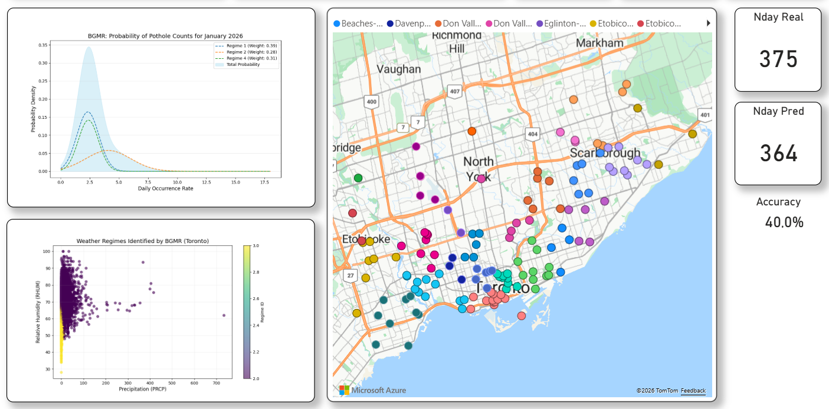
Forecast Analysis

Slide 11
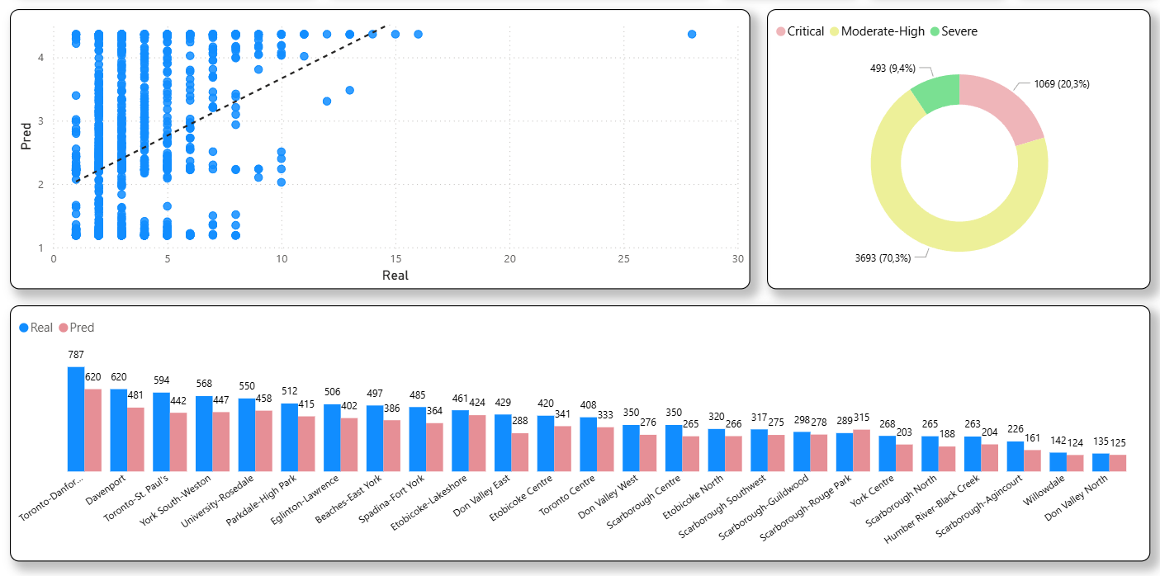
Forecast Analysis

Slide 12
Conclussions
This study shows that temperature is not the sole driver of road failure. By using feature importance, we proved that Atmospheric Pressure (PRES) and Relative Humidity (RHUM) are critical "silent killers." When high humidity saturates the road base and pressure drops during a storm front, the asphalt loses its structural integrity. This proves that a multidimensional weather model is far more accurate than simply tracking the thermometer.
By implementing Bayesian Gaussian Mixture Regression (BGMR), this project successfully shifted the perspective from "counting past holes" to "predicting future risks." The model identified that 70% of the study area reached a Moderate-High risk state (score of 2.37) in January 2026. This allows city officials to move away from 311 complaint-based repairs—which are biased by caller volume—and toward a Probabilistic Risk Assessment that targets physical road fatigue before it becomes a hazard.
The success of this 2026 forecast relied heavily on the Normalization of Intersection-Day Occurrences. By spending three months manually geocoding thousands of intersections and filtering out duplicate reports, we created a high-fidelity "Ground Truth" dataset. This process demonstrated that is essential to correct GPS drift and reporting bias manually, ensuring that 20% of "Critical" zones are accurately identified for immediate repair.

